Slide 1

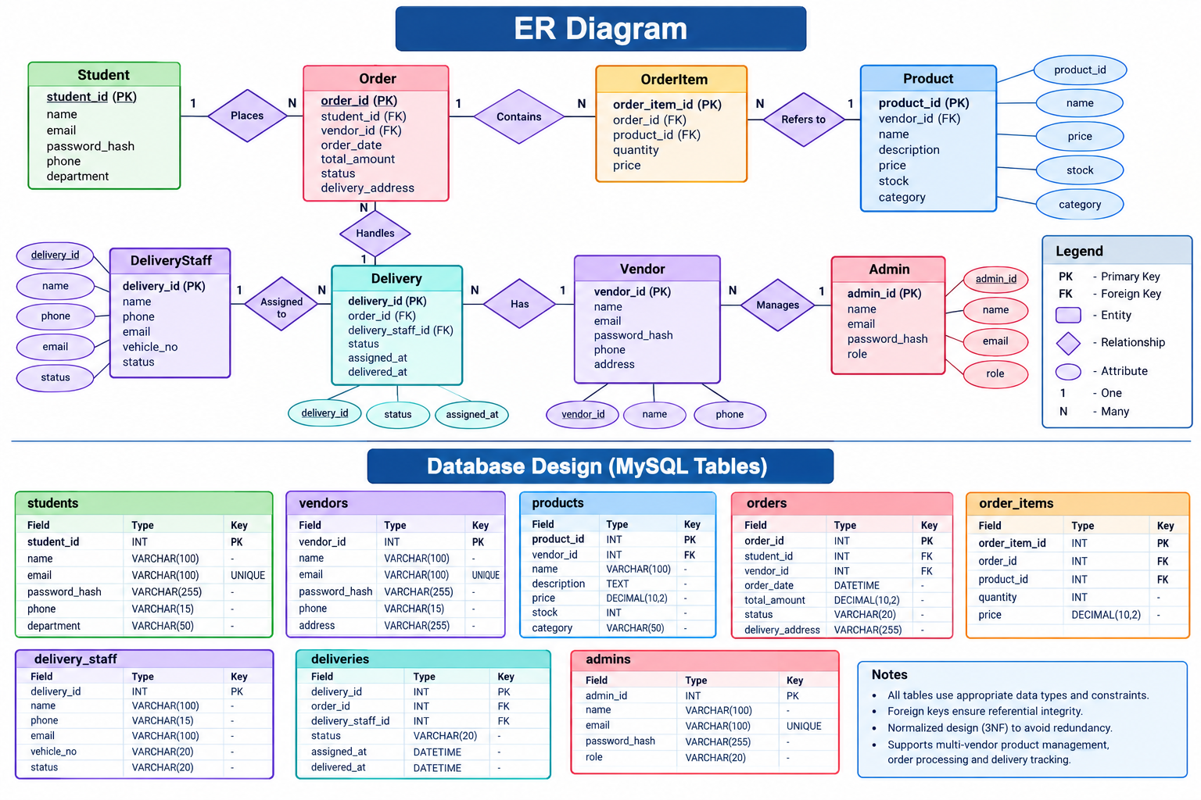
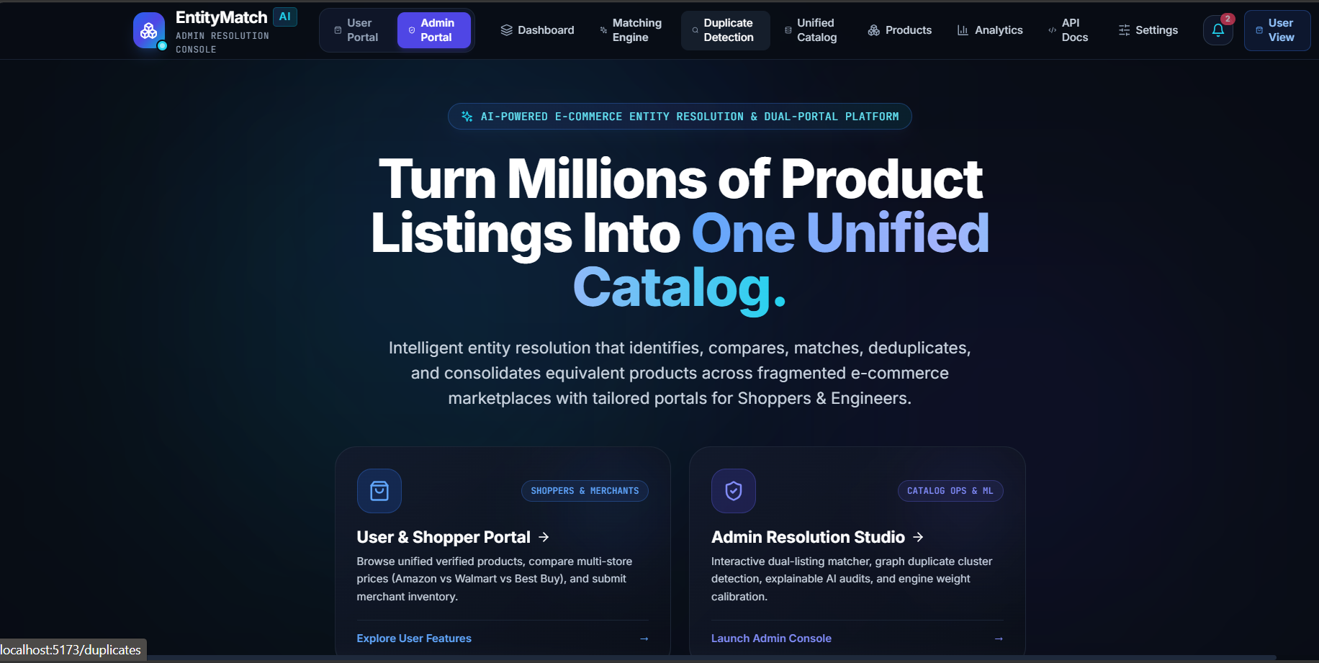
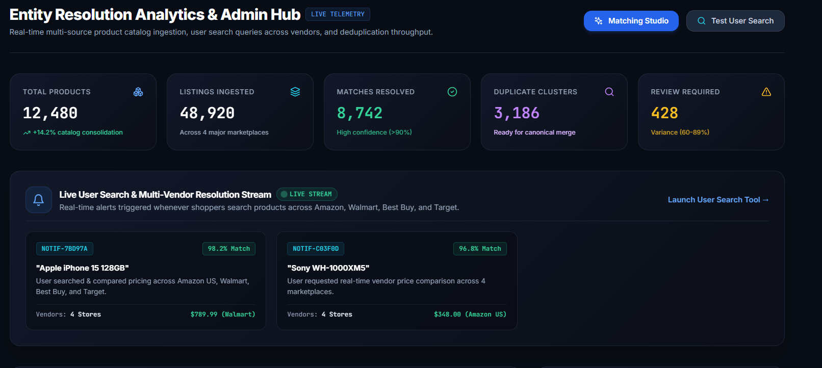

KLH Logo
Multi-Vendor Campus Marketplace & Delivery Platform
Team ID: 9 | Section: 10 | Members: V. Bhardwaj – 2520090182, P. Uday – 2520090089, A. Chaitanya – 2520090094 | Guide: Mrs. Divya Priya Degala
Database Systems Engineering and Distributed Backend Development (25CS1302E) | KLH Bachupally Campus, CSIT | PBL 2026-27
Abstract
Tools & Technologies
A web platform where campus vendors list products and students order for on-campus delivery. Built with React, Node.js REST APIs and MySQL.
Outcome: one place for many vendors, faster ordering, tracked deliveries.
Front-End: React (HTML, CSS, JavaScript)
Back-End: Node.js + Express, REST APIs
Database: MySQL
Tools: Git & GitHub, Postman, VS Code, Draw.io
Problem Statement & Objectives
Problem: Campus vendors work separately; students have no single system to browse, order and track.
Objective 1: Multi-vendor catalogue with role-based access
Objective 2: Order and delivery tracking workflow
Objective 3: Normalised DB with validated REST APIs
Scope: Students, vendors, delivery staff and admin; single campus.
System Architecture
Users: Student | Vendor | Delivery Staff | Admin
Front-End
React (Web UI)
Login / Register
Catalogue
Cart, orders
Vendor panel
REST API Layer
Node.js + Express
Auth & roles
Catalogue APIs
Order APIs
Delivery APIs
Database
MySQL
Users, Vendors
Products, Orders
Payments
Deliveries
JSON
SQL
Existing vs Proposed System
Feature | Existing System | Proposed System
Ordering | Calls, walk-ins | One online catalogue
Vendors | Separate | Many vendors, one app
Delivery | Manual, untracked | Order status tracking
Records | Paper, scattered | Central MySQL DB
Gap | No unified system | One integrated platform
ER Diagram & Database Design
[Insert ER diagram with entities, keys and relationships]
Feasibility Study
Technical: Team knows React, Node.js and SQL; all tools are free.
Economic: Open-source stack with free-tier hosting; no licence cost.
Operational: Simple interface for students and vendors; easy to maintain.
Schedule: Planned for completion within the semester timeline.
Implementation Screenshots
[Screenshot 1]
[Screenshot 2]
Results & Testing
Conclusion
Future Scope
[Key outcomes / test results]
[CRUD, validation, performance]
Working multi-vendor ordering and delivery platform.
Meets the objectives of unified ordering and tracking.
Real-time notifications and payment gateway
Mobile app and delivery route optimisation
References: [1] React Documentation, React – Official Documentation, Meta Platforms, Inc. React Documentation
[2] Node.js Documentation, Node.js – Official API Documentation. Node.js Documentation
[3] MongoDB Documentation, MongoDB – Database Documentation. MongoDB Documentation
QR: GitHub

